Slide 1
Temperature Controlled Fan
Submission Date: 5th May, 2023

Slide 2
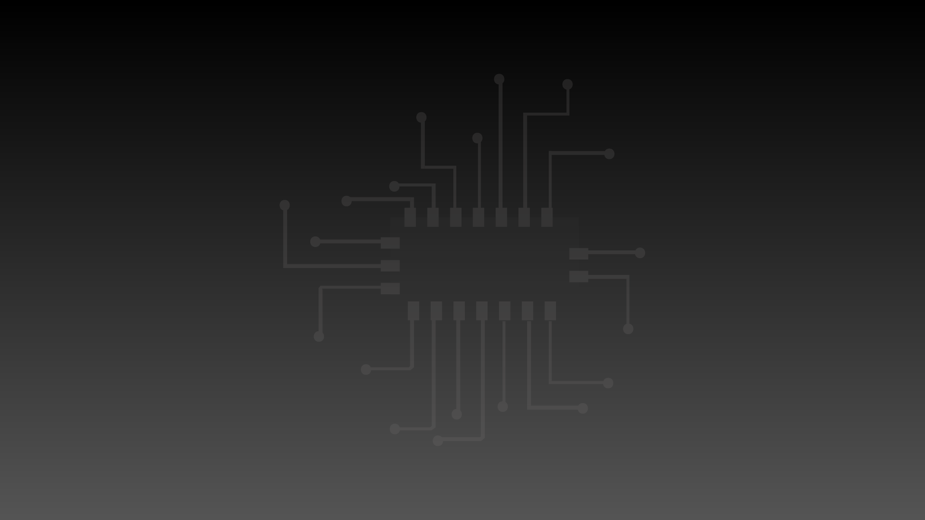

Group Members
ROLL NO | REGISTRATION NUMBER | SECTION | NAMES
24 | PIYUSH PARIPRAKASH DAS | EEE-B | 210906196
25 | SHAURYA PANDEY | EEE-B | 210906202
26 | SHASHANK PANDEY | EEE-B | 210906204
27 | TITHI MISHRA | EEE-B | 210906206

Slide 3
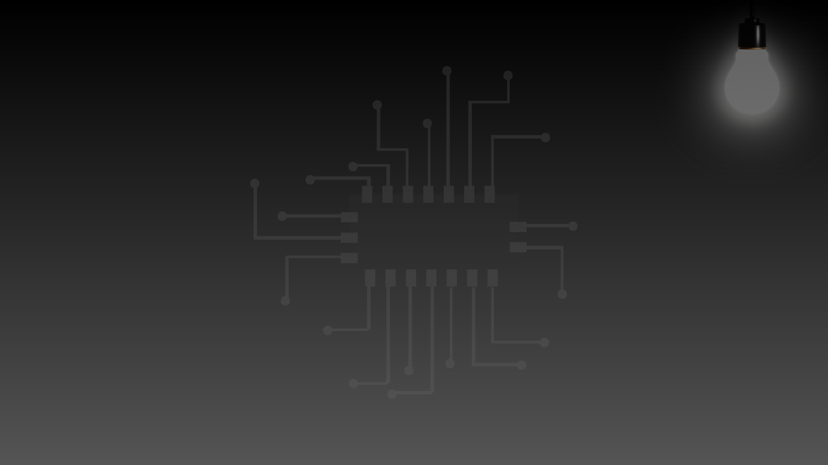
Problem Statement
“Design system level solutions or processes for engineering problems that meet the specified needs with appropriate consideration for public health and safety, and cultural, societal, and environmental considerations with an understanding of the limitations.”

Slide 4
Aim
The main aim of this project is to calculate and monitor the surrounding temperature and change the speed of the fan as temperature changes i.e. the speed should increase with a rise in temperature and should decrease with a drop in temperature.

Slide 5
Benefits
By controlling the speed of the fan at different temperature’s we save a lot of energy throughout the day. Instead of a fan running at full speed all day which requires a lot of energy, if the speed is controlled and given as necessary we can save a lot of energy.

Slide 6
Components, Tools and Technologies
Components Used
Tools and Technologies
Microcontroller AT89C52
ADC0804
16*2 LCD Display
LM35 Sensor
Resistors, Capacitors, Diodes
Crystal Oscillator
Electric Fan
Adapter
Male to Male, Male to Female Wires
KEIL MICROVISION 5
Proteus Simulation Software
Presentations.AI
Lucidchart

Slide 7
Engineering Systems, Variables, Parameters
Engineering Systems
Variables and Parameters
Temperature Sensor
Microcontroller
Fan Motor
Temperature Range
Fan speed
Ambient temperature
Control temperature

Slide 8
Block Diagram
Block Diagram
LCD
SENSOR
ADC
MICROCONTROLLER
FAN

Slide 9
Programming Algorithm
The programming algorithm involves measuring the temperature with the LM35 sensor and adjusting the speed of the fan motor using the L298N motor driver.

Slide 10
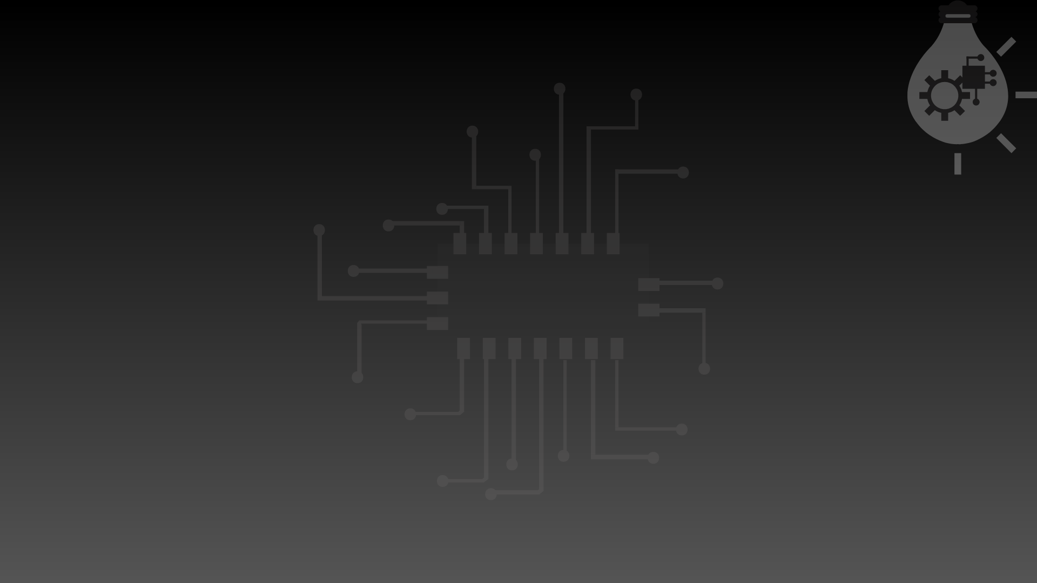
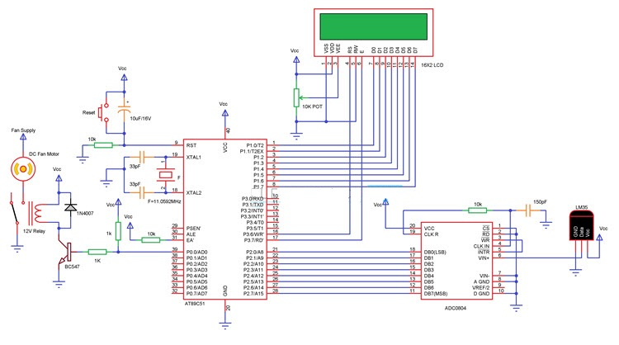
Circuit Diagram

Slide 11

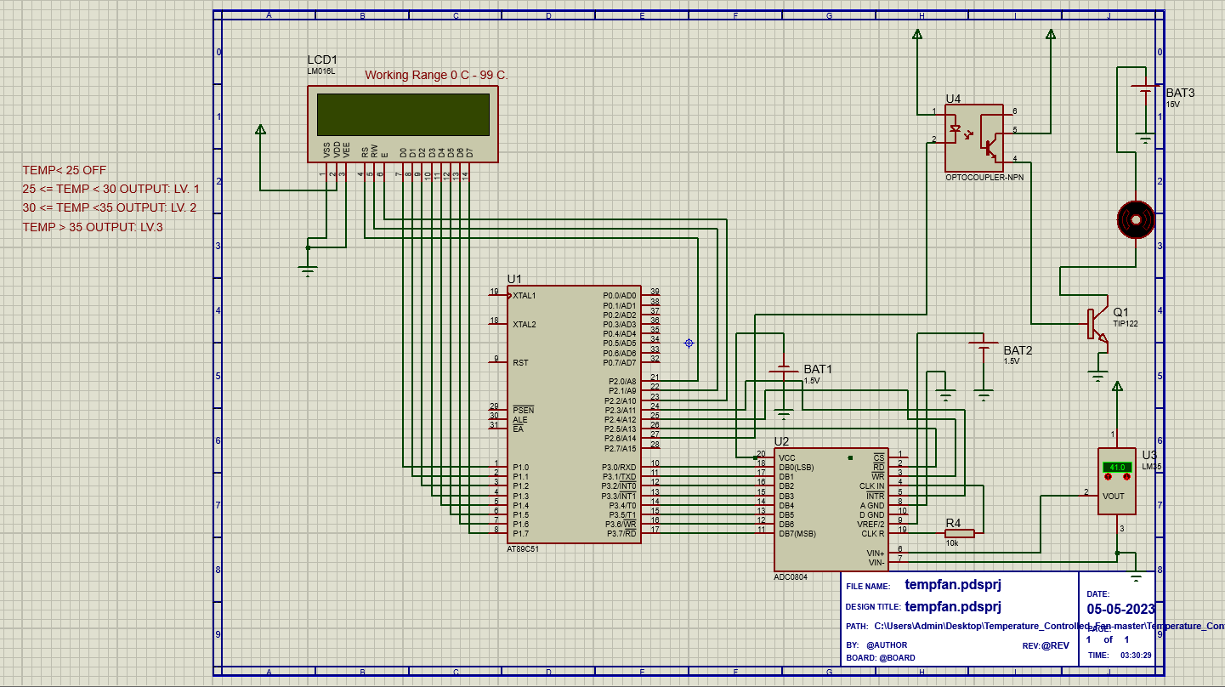
Proteus Simulation
This is the Proteus Simulation of our Circuit.

Slide 12
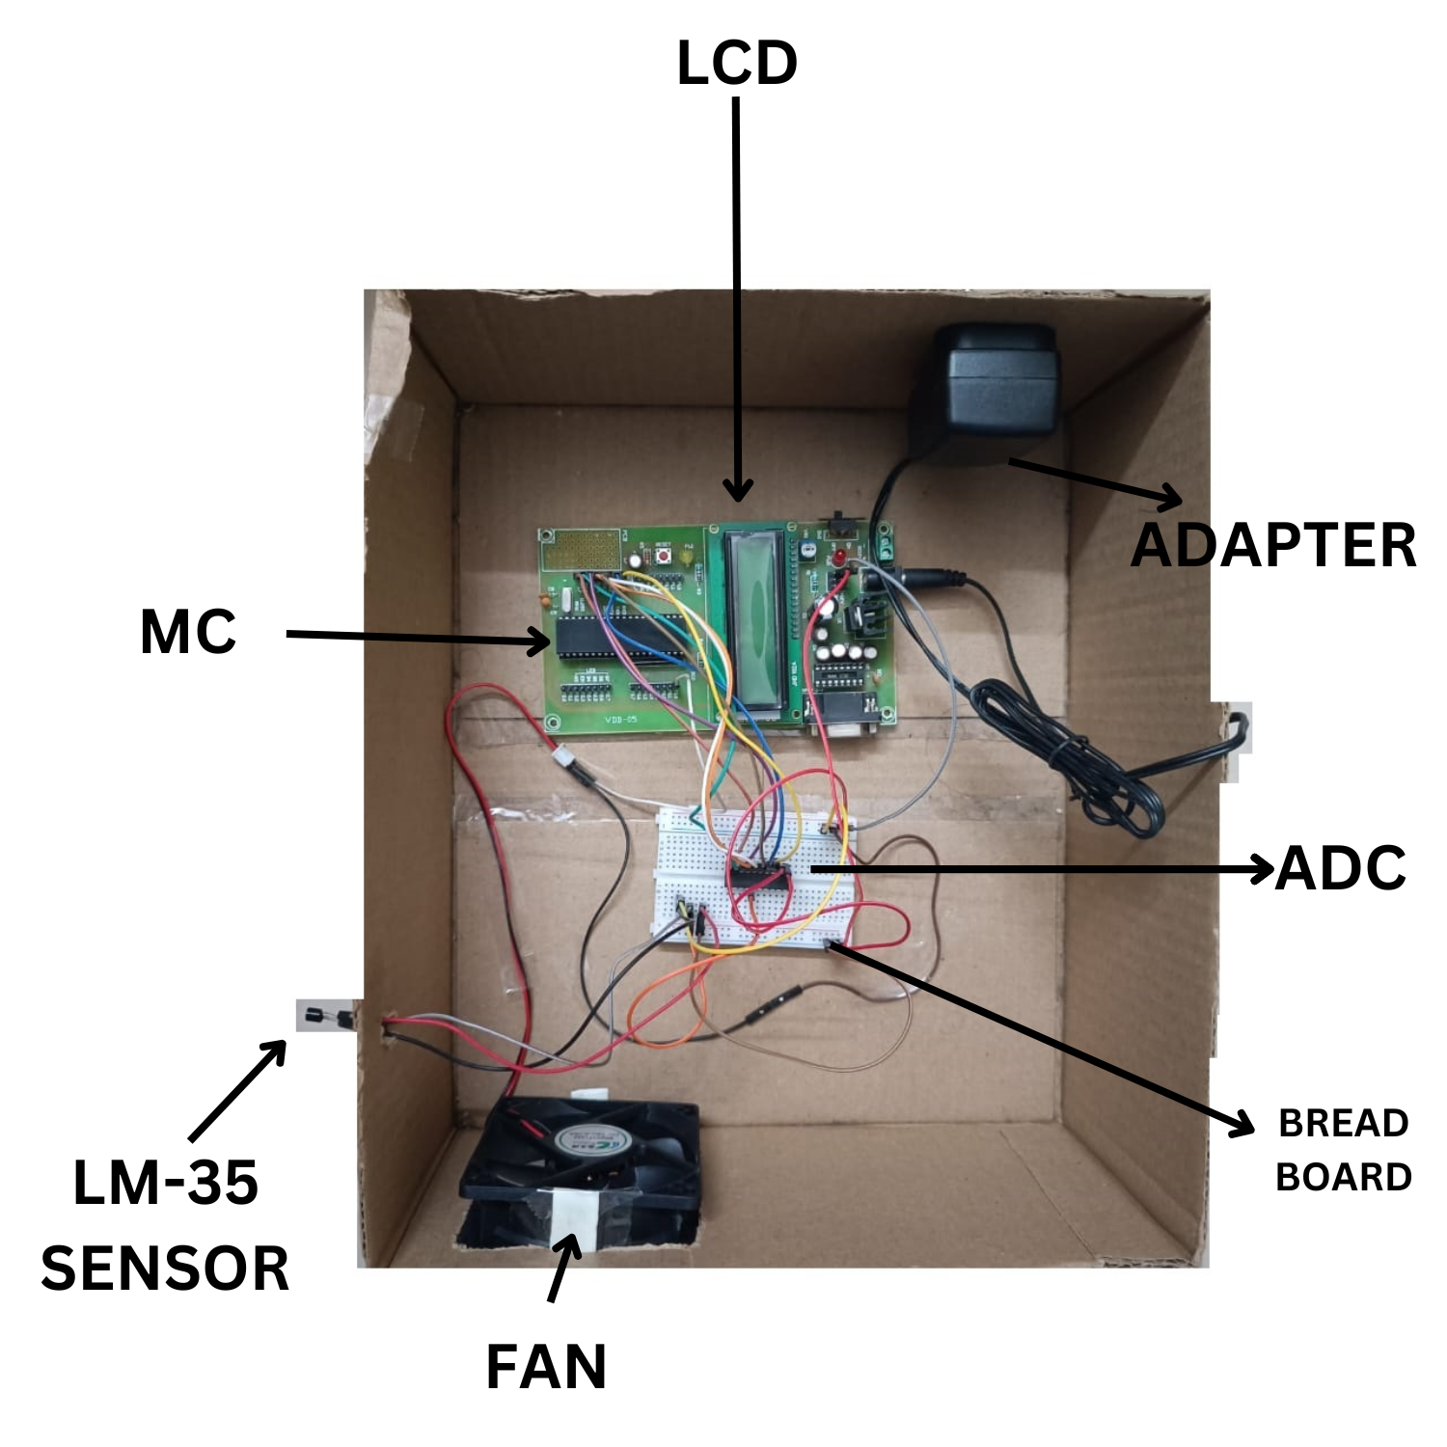
Hardware Implementation
This is the Proteus Simulation of our Circuit.

Slide 13
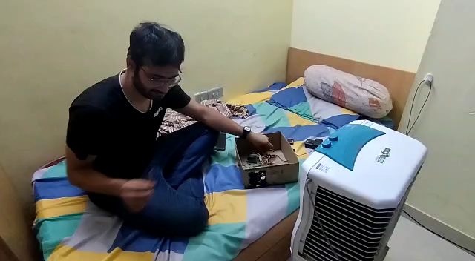
Hardware Demonstration

Slide 14
Results
The project was simulated using Proteus simulation software, and the results were successful. The fan motor speed increased as the temperature increased and decreased as the temperature decreased. A hardware prototype was also built and tested, and the results were consistent with the simulation.

Slide 15
Limitations
The temperature-controlled fan has a limited temperature range and cannot operate outside the range of the temperature sensor. The system may also require calibration due to sensor drift over time.

Slide 16
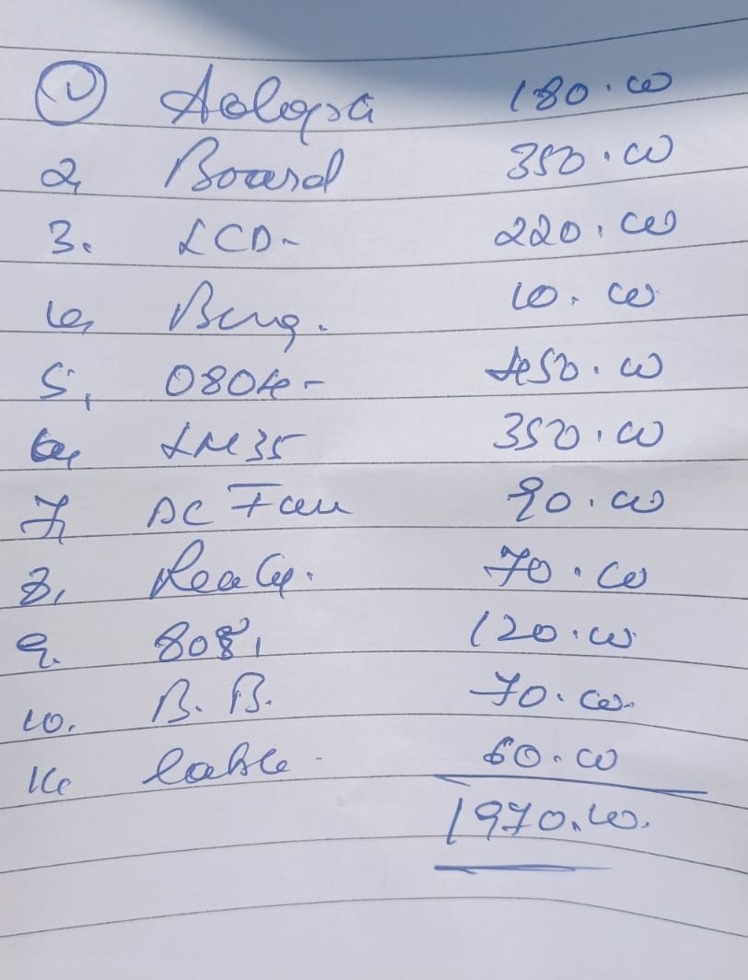
Bill of Materials
Transportation Cost = 300/ -
Additional Charges – 100/-
Extra Jumper Wires – 80/-
Total Cost = Rs. 2450/-

Slide 17
Conclusions
In conclusion, the temperature-controlled fan project successfully achieved its objectives by designing a system that can monitor the temperature and adjust the fan speed accordingly. The project utilized the principle of thermodynamics and control systems to achieve the desired temperature range, and the simulation and hardware prototype tests produced consistent results. The limitations of the project were identified, and modern engineering tools and techniques that can improve the project were suggested. An alternative design solution using a closed-loop control system with a PID controller was proposed. The project's impact on public health and safety, societal, cultural, and environmental considerations was also discussed. Effective collaboration and communication between team members are essential for successful completion of the project. Finally, a bill of materials was provided for the implementation of the temperature-controlled fan.

Slide 18
Individual Contributions
Piyush Pariprakash Das
Shaurya Pandey
.C code execution
Hex File Creation
Report Creation
Hardware Procurement
Proteus Design Explanation
Hardware designing

Slide 19
Individual Contributions
Shashank Pandey
Tithi Mishra
Hardware Procurement
.C code designing
Proteus Simulation and testing
Hardware designing
Problem Statement Analysis
Hardware Procurement
Presentation Preparation

